Slide 1
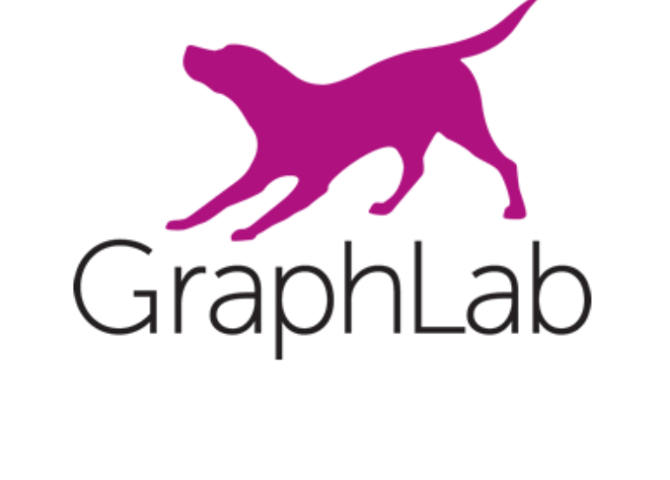
A Distributed Framework for Machine Learning and Data Mining in the Cloud
A presentation by Tushar Sudhakar Jee

Slide 2
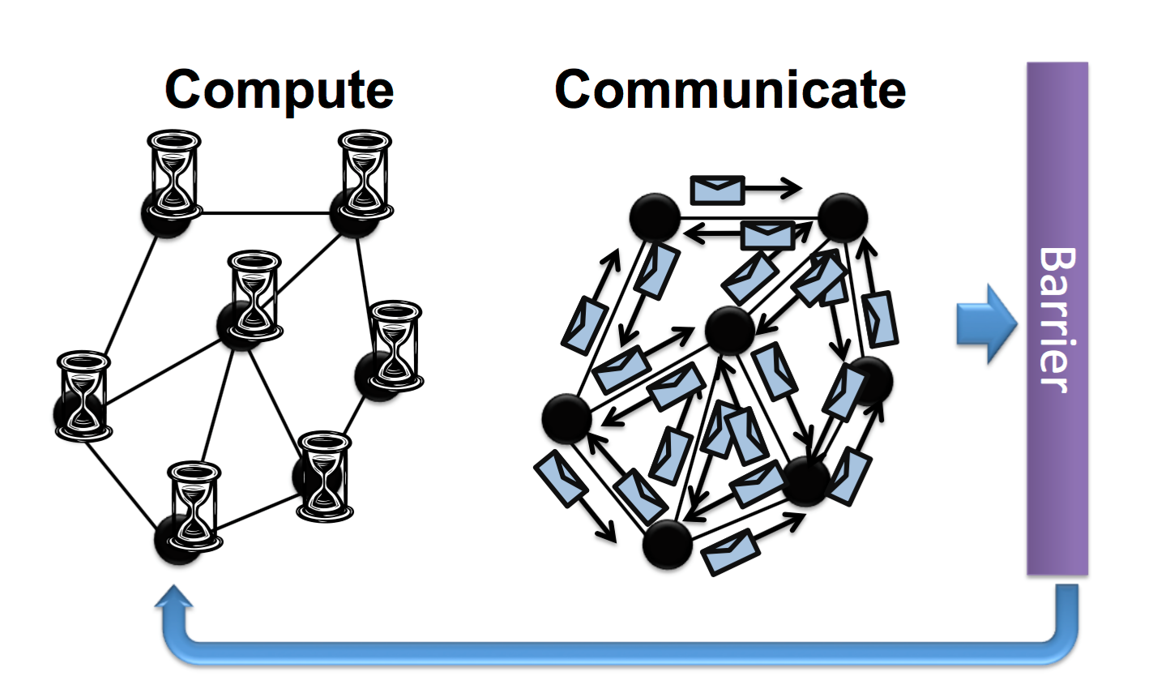
Bulk Synchronous Parallel(BSP)
• A bridging model for designing parallel
Algorithms(eg: message relaying).
• Implemented by Google Pregel 2010.
• The model consists of :
1. Concurrent computation:Every
participating processor may
perform local computations.
2. Communication: The processes
exchange data between
themselves to facilitate remote
data storage capabilities.
3. Barrier synchronisation : When a
process reaches this point (the barrier),
it waits until all other processes have
reached the same barrier.

Slide 3
Bulk Synchronous Parallel(BSP)
• Advantages:
1. No worries about Race conditions.
2. Barrier guarantees Data consistency.
3. Simpler to make fault tolerant,save data on barrier.
• Disadvantages:
1. Costly performance penalties since runtime of each phase is decided by
slowest machine.
2. Fail to support the properties of asynchronous,graph-parallel and dynamic
computation,critical to Machine Learning and Data Mining Community.

Slide 4
Asynchronous processing
• Implemented by GraphLab 2010, 2012 .
• Advantages:
1. Directly targets properties of asynchronous,graph-parallel and dynamic
computation,critical to Machine Learning and Data Mining Community.
2. Involves updating parameters using most recent values as input,most closely
related to Sequential execution.
• Disadvantages:
1. Race conditions can happen all the time.

Slide 5
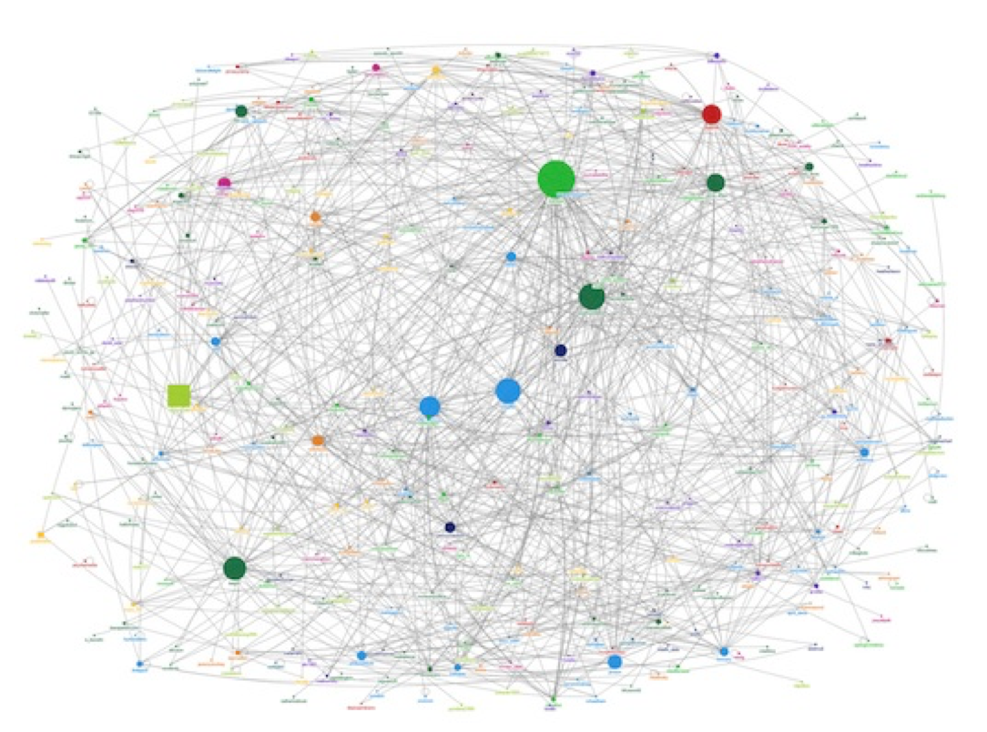
Why GraphLab?
•Implementing Machine Learning and Data Mining algorithms in parallel on current systems like Hadoop,MPI and MapReduce is prohibitively complex and costly.
•It targets asynchronous, dynamic, graph-parallel computation in the shared-memory setting as needed by the MLDM community.

Slide 6
MLDM Algorithm Properties
•Graph Structured Computation
•Asynchronous Iterative Computation
•Dynamic Computation
•Serializability

Slide 7
Graph Structured Computation
•Recent advances in MLDM focus on modeling the dependencies between data, as it allows extracting more signal from noisy data.
For example, modeling the dependencies between similar shoppers allows us to make better product recommendations than treating them in isolation.
•Consequently, there has been a recent shift toward graph-parallel abstractions like Pregel and GraphLab that naturally express Computational dependencies.

Slide 8
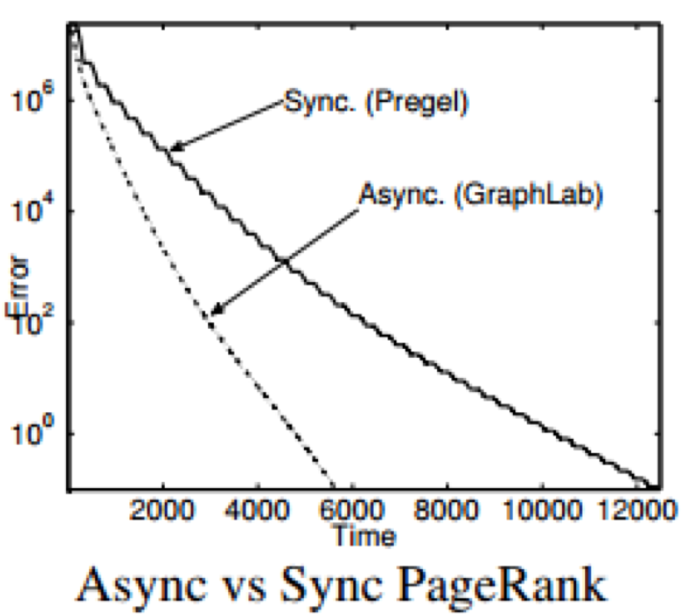
Asynchronous Iterative Computation
•Synchronous systems update all parameters simultaneously (in parallel) using parameter values from the previous time step as input.
•Asynchronous systems update parameters using the most recent parameter values as input.
Many MLDM algorithms benefit from asynchronous systems.

Slide 9
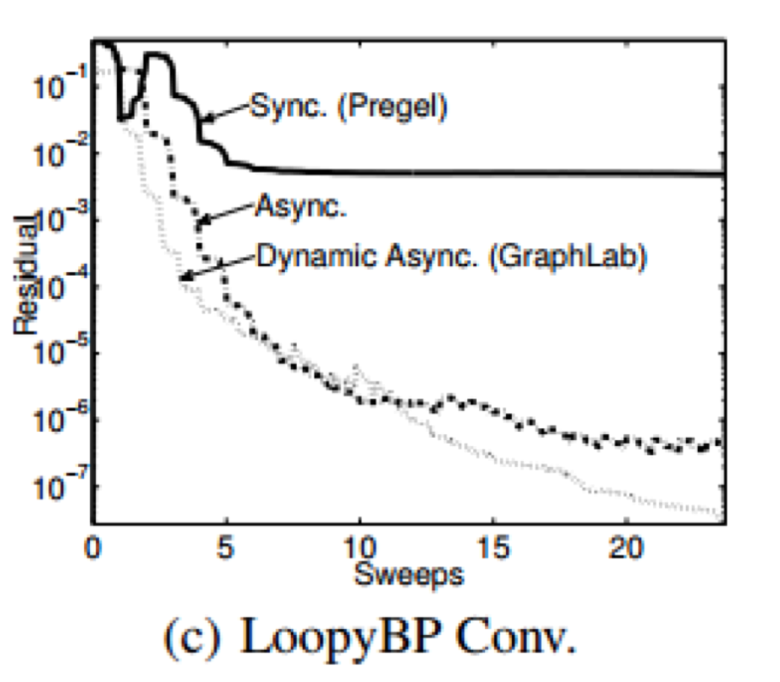
Dynamic Computation
•Dynamic computation allows the algorithm to save time since it only recomputes vertices with recently updated neighbors .
•Static computation requires the algorithm to update all vertices equally often. This wastes time recomputing vertices that have already converged.

Slide 10
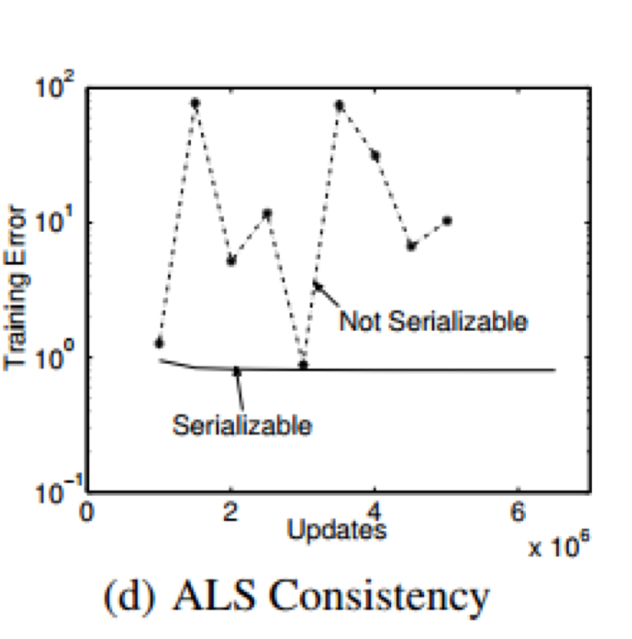
Serializability
•Serializability ensures that all parallel executions have an equivalent sequential execution,thereby eliminating race conditions.
•MLDM algorithms converge faster if serializability is ensured.Gibbs sampling, requires serializability for correctness.

Slide 11
Distributed GraphLab Abstraction
•Data Graph
•Update function
•Sync Operation
•GraphLab Execution Model
•Ensuring Serializability

Slide 12
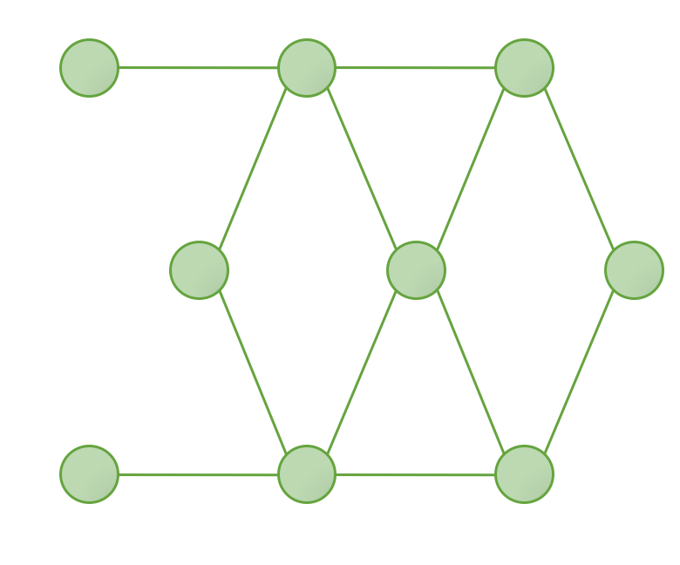
Data Graph
•The GraphLab abstraction stores the program state as a directed graph called the data graph, G = (V, E, D), where D is the user defined data.
Data here represents model parameters, algorithm state, and statistical data.
Data graph

Slide 13
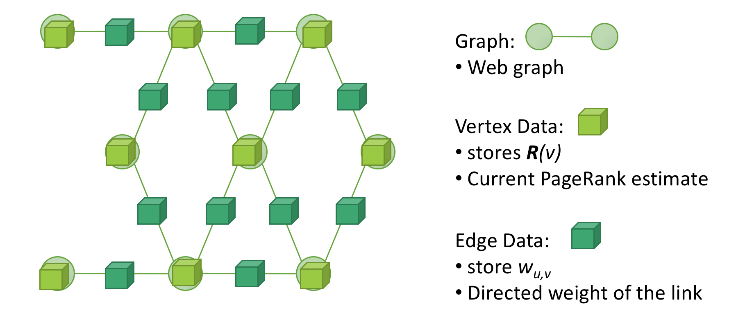
Data Graph (PageRank example):

Slide 14
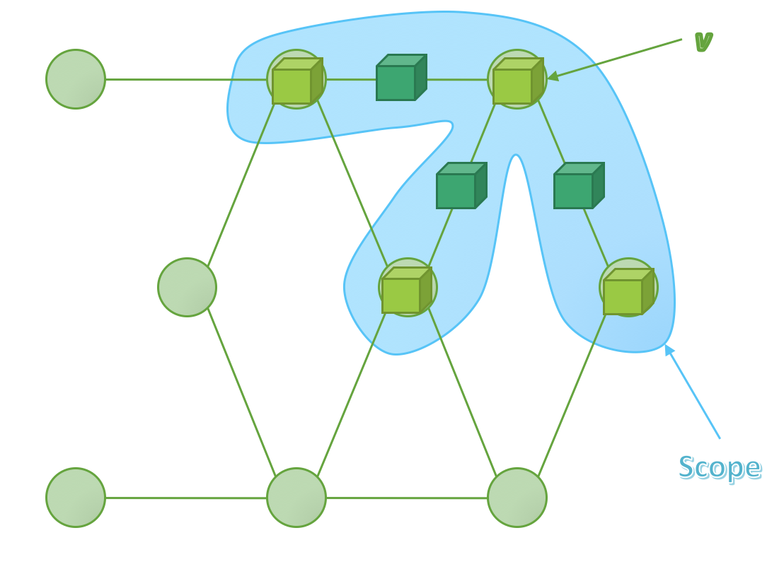
Update function
• An update function is a stateless procedure that modifies the data within the scope of a vertex and schedules the future execution of the update functions on other vertices.
•The function takes a vertex v and its scope S_{v} and returns new versions of the data in the scope as well as a set vertices T:
Update: f(v, S_{v} ) -> (S_{v} ,T)

Slide 15
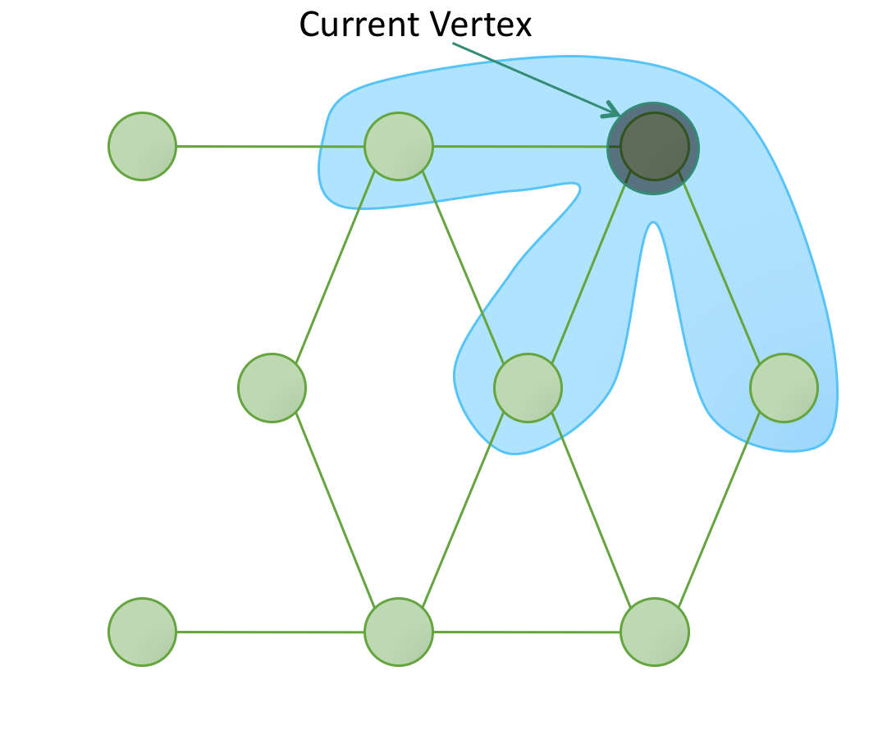
Update function(PageRank example):
•The update function for PageRank computes a weighted sum of the current ranks of neighboring vertices and assigns it as the rank of the current vertex.
• The Neighbors are scheduled for update only if the value of the current vertex crosses the threshold.

Slide 16
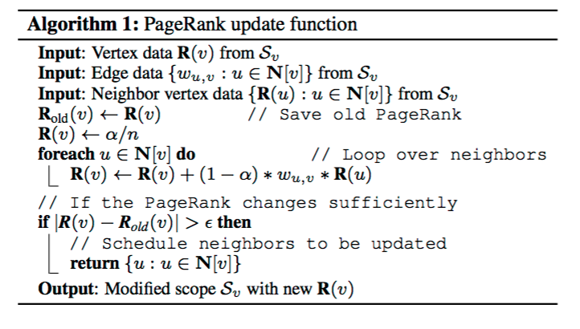
Update function(PageRank example):

Slide 17
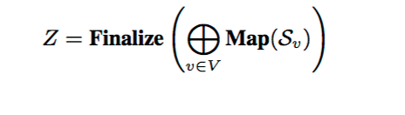
Sync Operation
•It is an associative commutative sum defined over all scopes in the graph.
•Supports normalization common in MLDM algorithms.
•Runs continuously in the background to maintain updated estimates of the
global value.
•Ensuring serializability of the sync operation is costly and requires
synchronization.

Slide 18
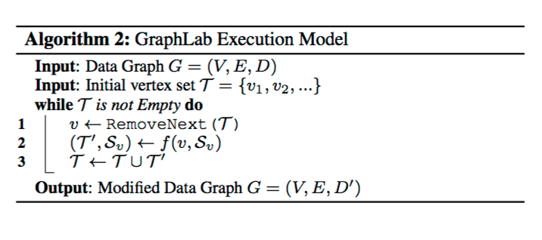
The GraphLab Execution Model
•The model allows the GraphLab runtime engine to determine best order in which to run vertices.
•Since many MLDM algorithms benefit from prioritization,GraphLab abstraction allows users to assign priorities to vertices in T.

Slide 19
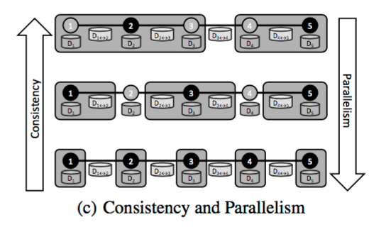
Ensuring Serializability
•It implies that for every parallel execution, there exists a sequential execution of update functions that would give the same results.
•For Serializability ensure no overlapping in scopes of concurrently executing scopes of update functions.
•The greater the consistency, the lower the parallelism.

Slide 20
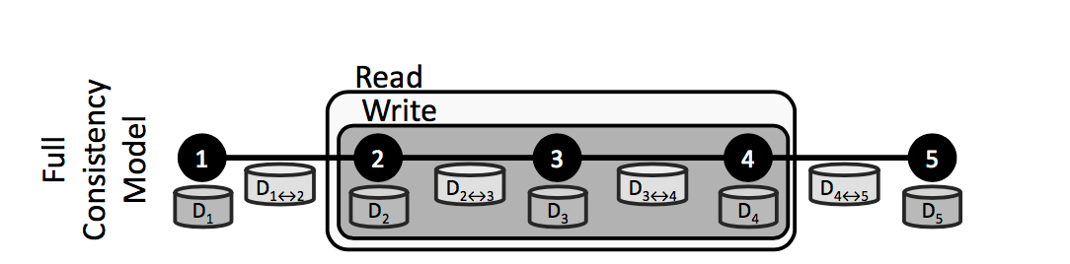
Ensuring Serializability(Full Consistency):
• This model ensures that scopes of concurrently executing update functions do not
overlap.
• Update function has complete read/write access to entire scope.
• Concurrently executing update functions must be at least two vertices apart
limiting parallelism.

Slide 21
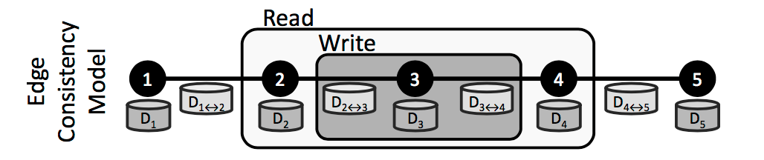
Ensuring Serializability(Edge Consistency):
• This model ensures each update function has exclusive read/write access to its
vertex and adjacent edges, but read only access to adjacent vertices.
• Increases parallelism by allowing update functions with slightly overlapping
scopes to run in parallel.

Slide 22
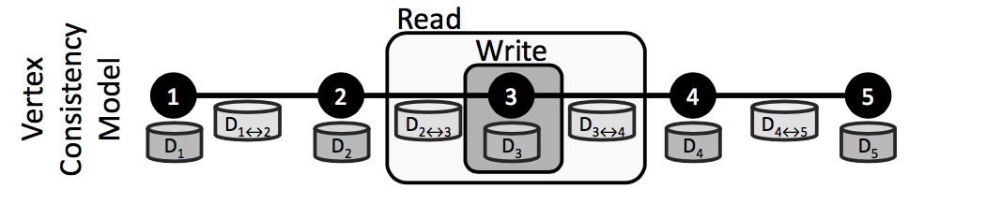
Ensuring Serializability(Vertex Consistency):
• This model provides write access to the central vertex data.
• It allows all update functions to be run in parallel, providing maximum
parallelism.
• It is the least consistent.

Slide 23
Using GraphLab(K-means):
• Using GraphLab Create K-means with dataset from the June 2014
Kaggle competition to classify schizophrenic subjects based on MRI scans.
• The original data consists of two sets of features: functional network
connectivity (FNC) features and source-based morphometry (SBM) features,
incorporated into a single SFrame with SFrame.join.
• Data downloaded from public AWS S3 bucket.

Slide 24
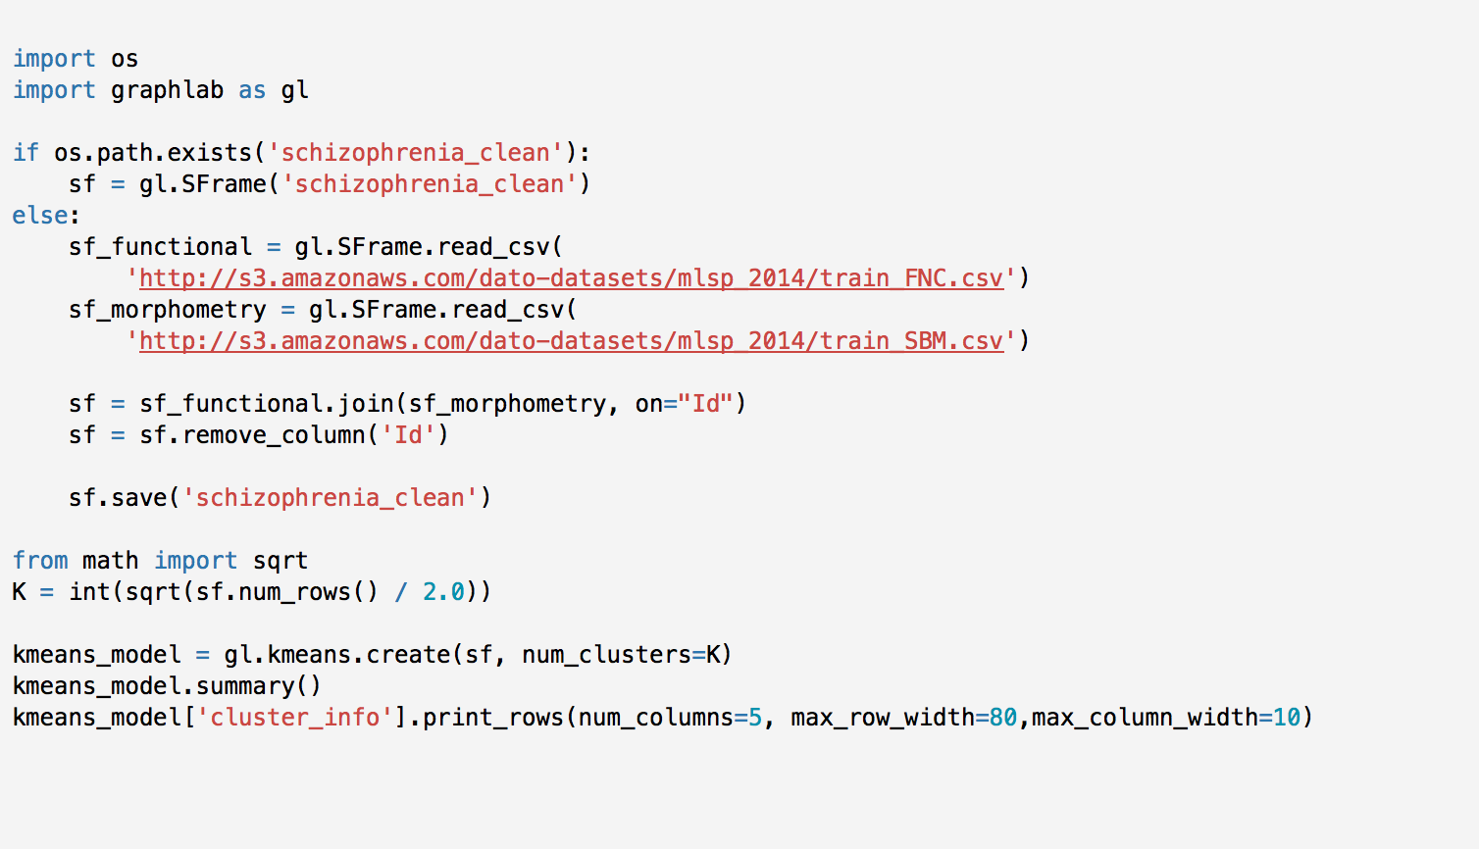

Slide 25
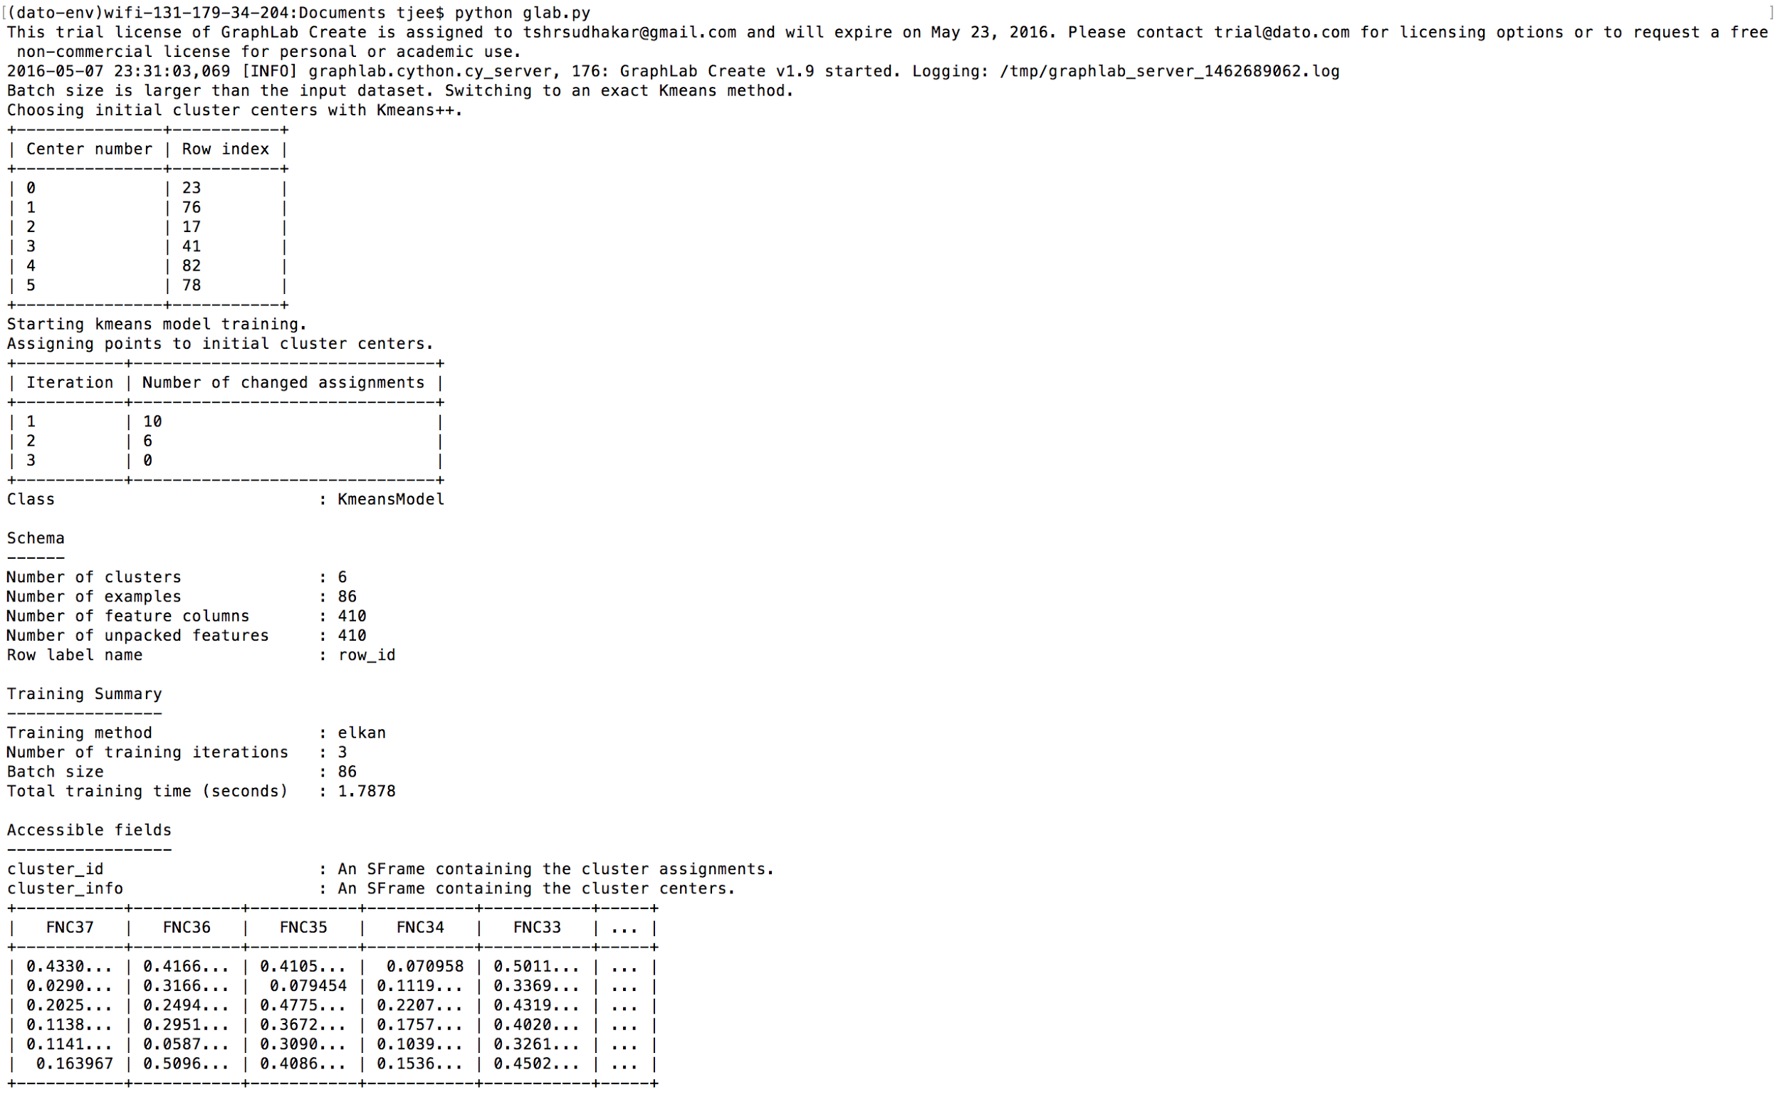

Slide 26
Distributed GraphLab Design
•Distributed Data Graph
•Distributed GraphLab Engines
•Fault tolerance
•System design

Slide 27
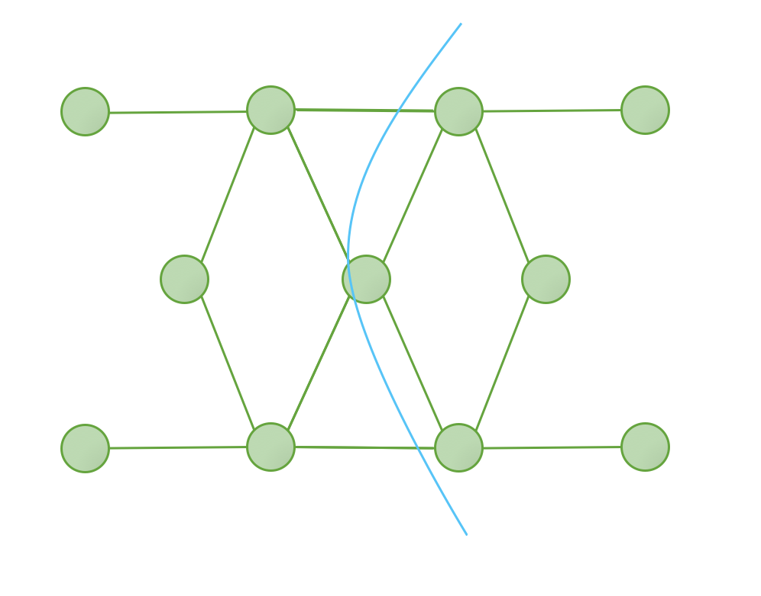
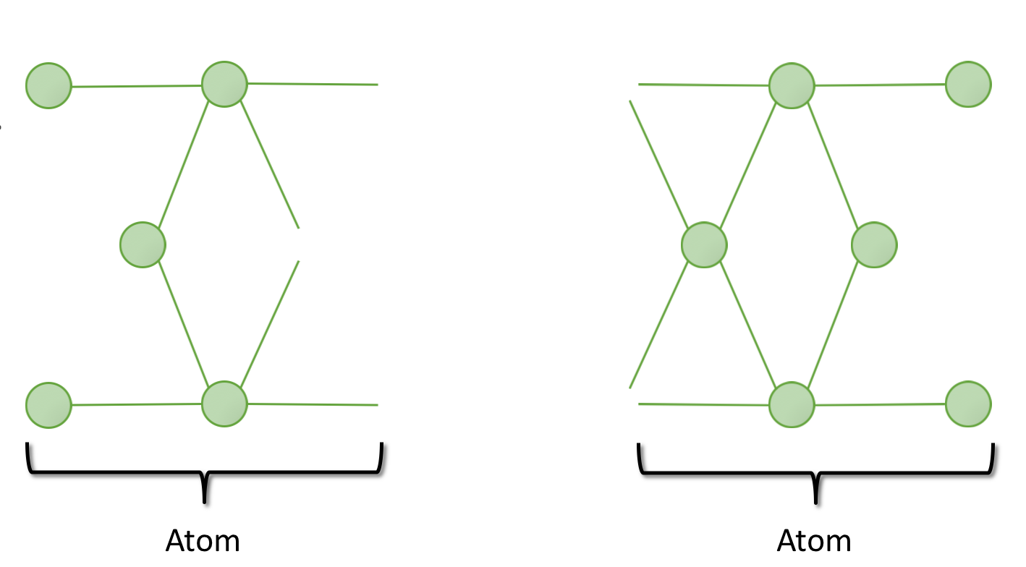
Distributed Data Graph
•A graph is partitioned into k parts where k is much greater than the number of machines.
•Each part, called an atom is stored as a separate file on a distributed storage system(Amazon S3).

Slide 28
Distributed GraphLab Engines:
1. Emulates the GraphLab execution model and is responsible for:
•Executing update functions.
•Executing sync operations.
•Maintaining the set of scheduled vertices T.
•Ensuring serializability with respect to the appropriate consistency model
2. Types:
• Chromatic Engine
• Distributed Locking Engine

Slide 29
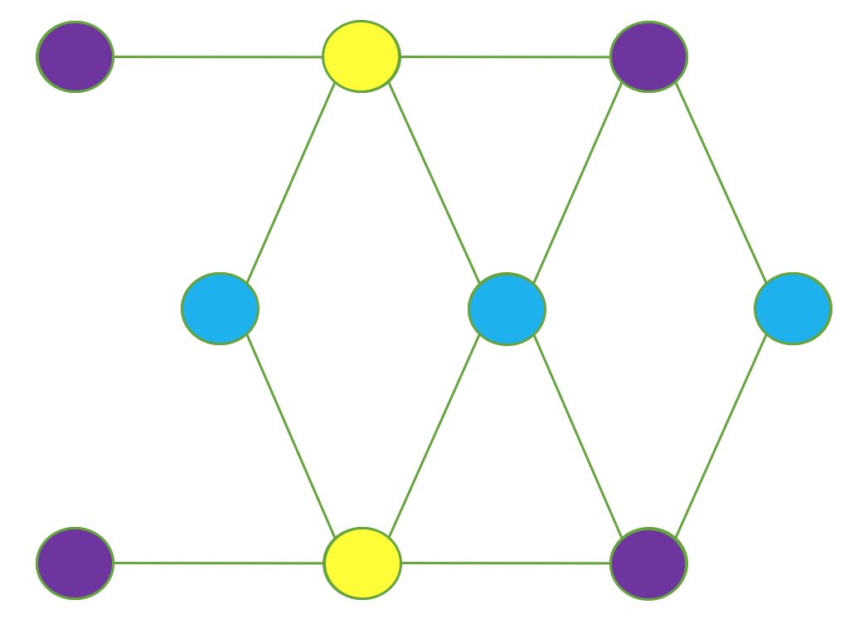
Chromatic Engine:
•It uses vertex coloring to satisfy the edge consistency model by executing synchronously all vertices of the same color in the vertex set T before proceeding to the next color.
•Full consistency model is satisfied by ensuring that no vertex shares the same color as any of its distance two neighbors.
•Vertex consistency model is satisfied by assigning all vertices the same color.
• It executes the set of scheduled vertices T partially asynchronously.
Edge Consistency model using Chromatic Engine.

Slide 30
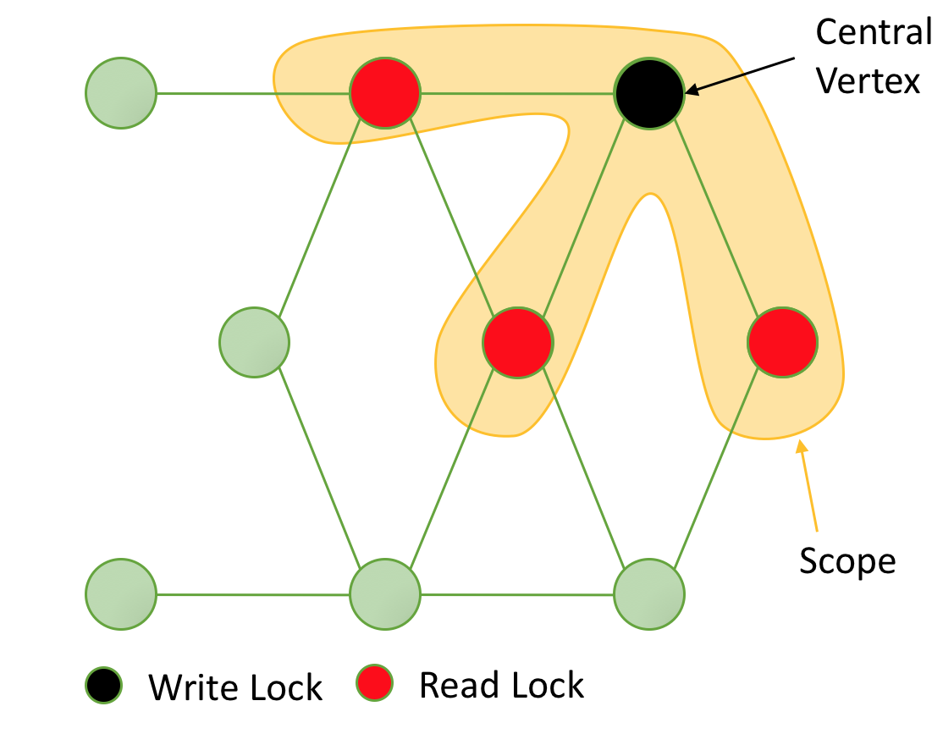
Distributed Locking Engine
1. Why use it?
•Chromatic engine does not provide
sufficient scheduling flexibility.
• Chromatic engine presupposes availability
of graph coloring which might not always
be readily available.
2.The Distributed Locking Engine uses mutual exclusion by associating a readers-writers lock with each vertex.
3.Vertex consistency is achieved by acquiring a write-lock on the central vertex of each requested scope.

Slide 31
4. Full consistency is achieved by acquiring write-locks on the central vertex and all adjacent vertices.
5.Edge consistency is achieved by acquiring a write-lock on the central vertex and read locks on adjacent vertices.

Slide 32
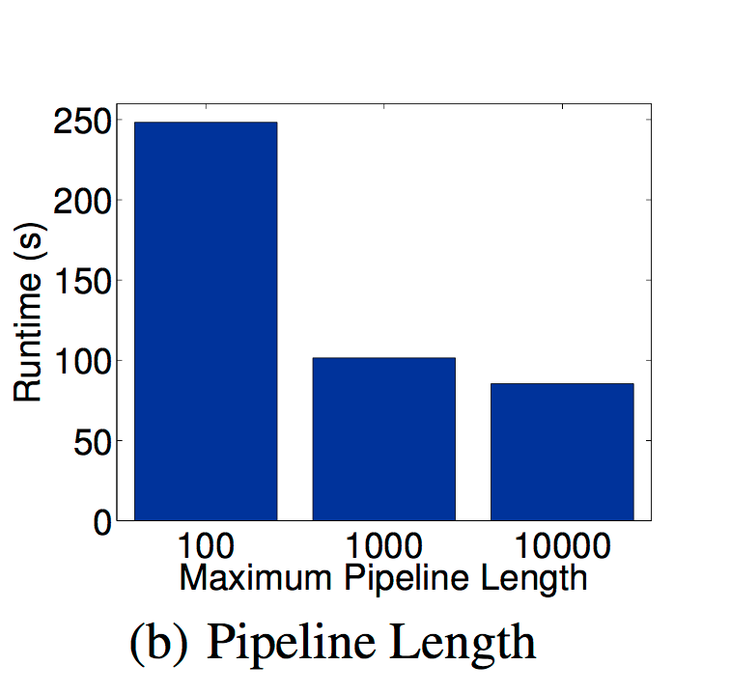
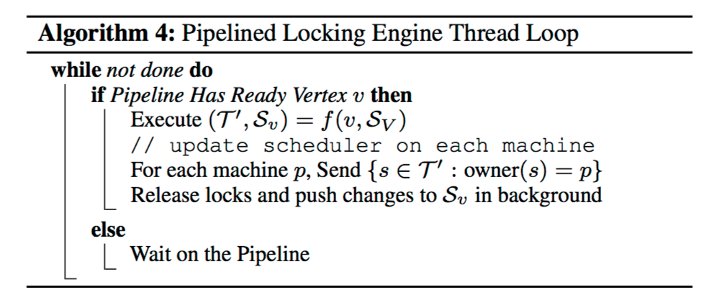
Distributed Locking Engine(Pipelined locking)
•Each machine maintains a pipeline of
vertices for which locks have been
requested, but not yet fulfilled.
•The pipelining system uses callbacks
instead of readers/writer locks since the
latter would halt the pipeline.
•Pipelining reduces latency by
synchronizing locked data immediately
after a machine completes its local lock.

Slide 33
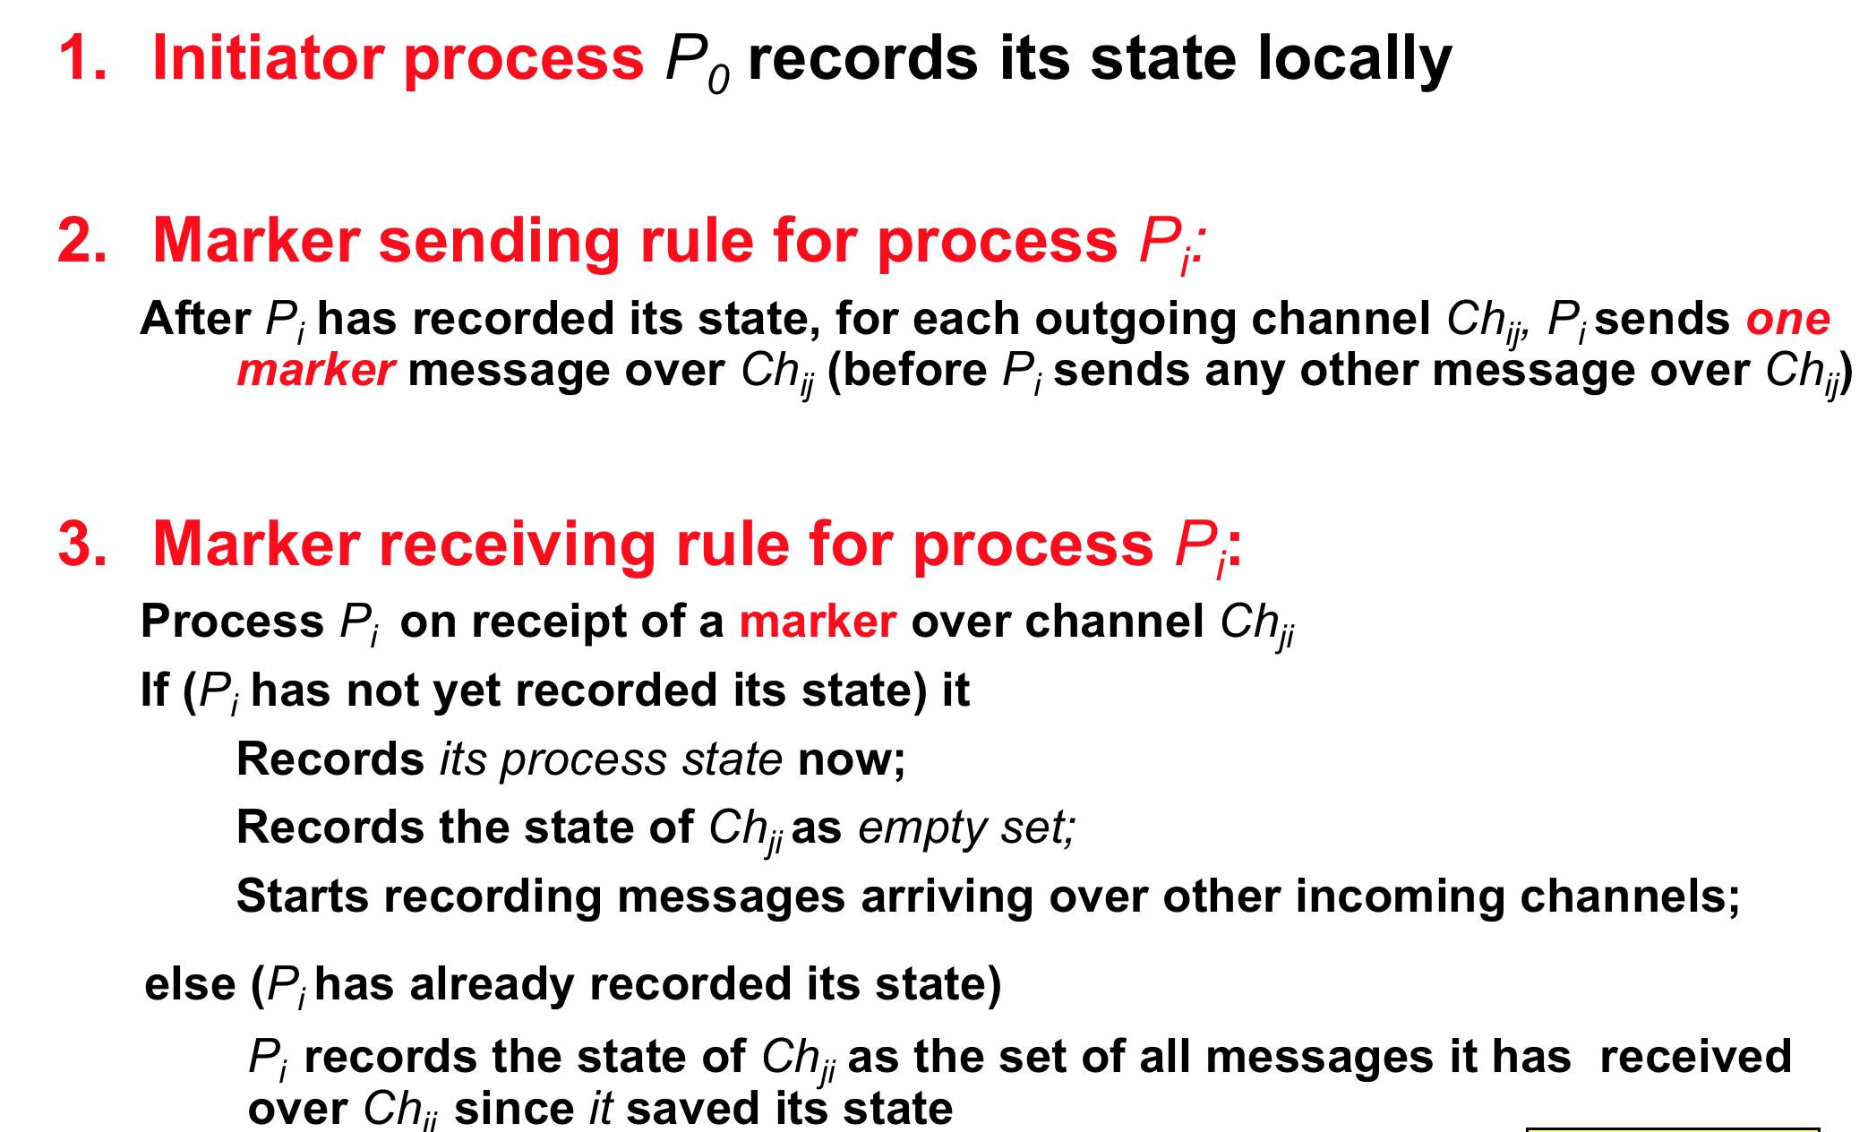
Chandy-Lamport Snapshot Algorithm

Slide 34
Fault Tolerance
•Using a distributed checkpoint mechanism called Snapshot Update fault tolerance is introduced in GraphLab.
•Snapshot Update can be deployed synchronously or asynchronously.
•Asynchronous snapshots are more efficient and guarantee consistent snapshot under the following conditions:
a)Edge consistency is used on all update functions.
b)Schedule completes before the scope is unlocked.
c)Snapshot Update is prioritized over other updates.

Slide 35
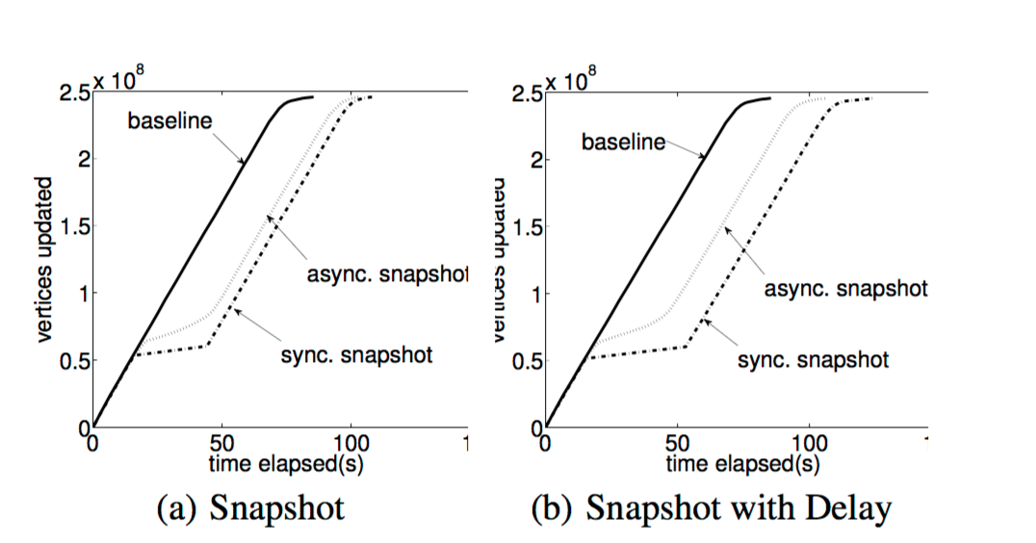
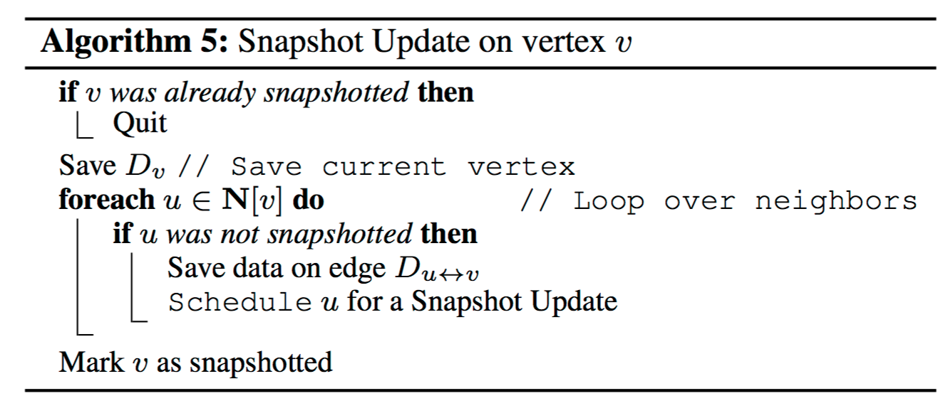
Synchronous snapshot have the “flatline” whereas asynchronous snapshots allow computation to proceed.

Slide 36
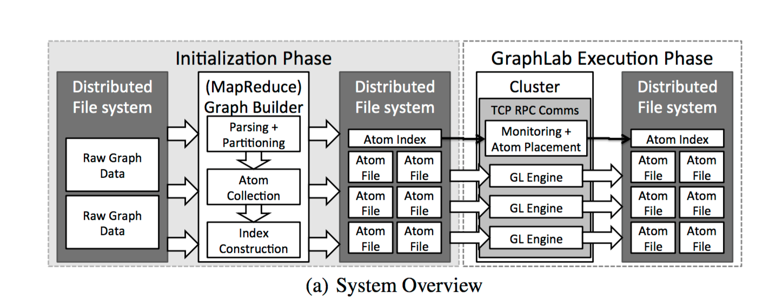
System design
In the Initialization phase the atom file representation of data graph is constructed.
In the GraphLab Execution Phase atom files are assigned to individual execution engines from the DFS.

Slide 37
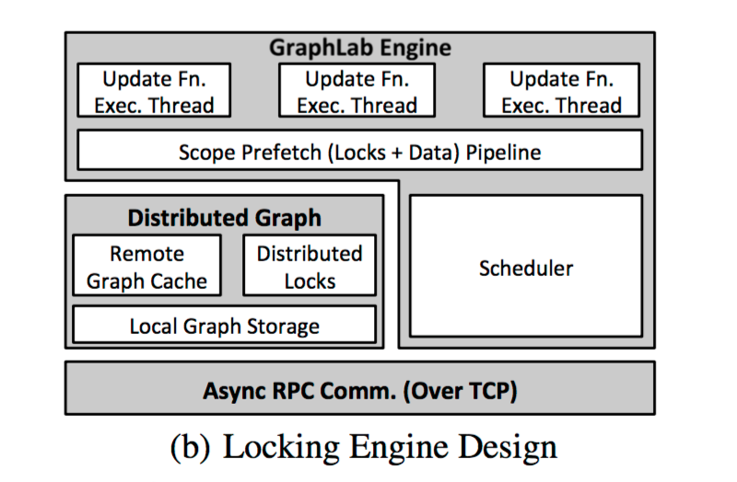
System design(Locking Engine Design)
• Partition of distributed graph managed within Local Graph storage.
• Cache used to provide access to remote data.
• Scheduler manages vertices in T assigned to the process. • Each block makes use of block below it.

Slide 38
Applications
Netflix Movie Recommendation
Video Co-segmentation(Coseg)
Named Entity Recognition(NER)

Slide 39
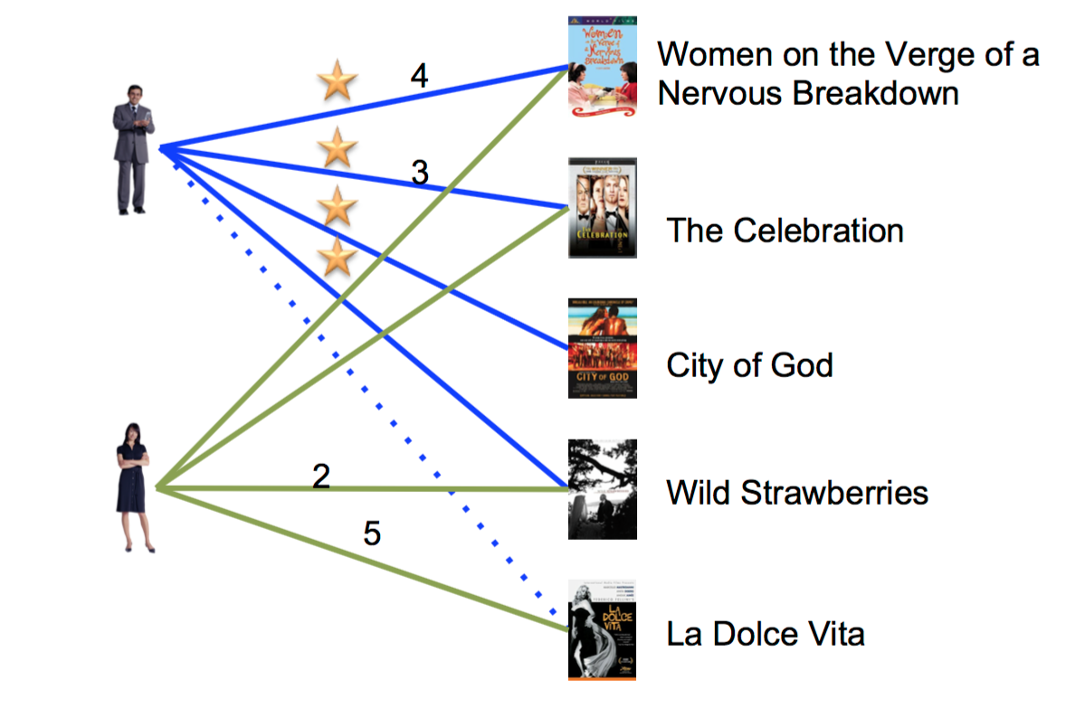
Netflix Movie Recommendation
It makes use of collaborative filtering to predict the movie ratings for each user based on the ratings of similar users.
The alternating least squares(ALS) algorithm is used to iteratively compute a low-rank matrix factorization.
The sparse matrix R defines a bipartite graph connecting each user with the movies that they rated.
Vertices are users(rows U) and movies(columns V) and edges contain the ratings for a user-movie pair.
GraphLab update function predicts ratings(edge-values).

Slide 40
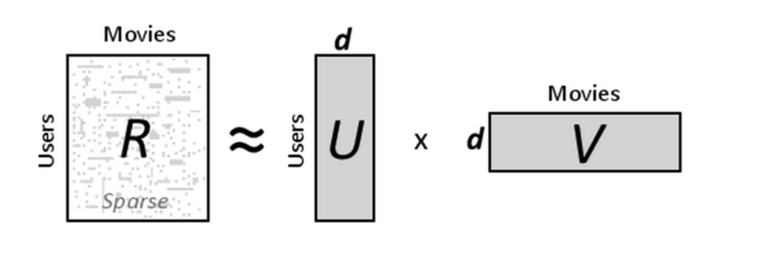
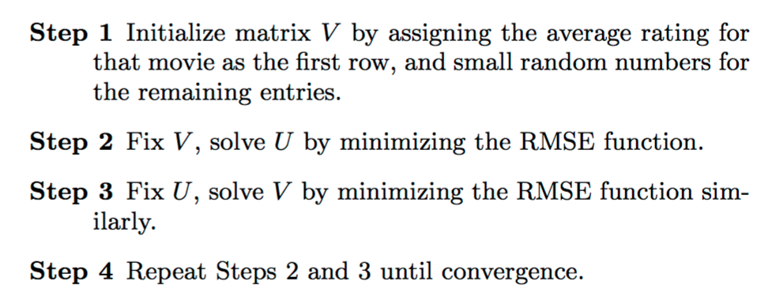
•ALS rotates between fixing one of the unknowns ui or vj. When one is fixed the other can be computed by solving the least-squares problem. The ALS algorithm is as:

Slide 41
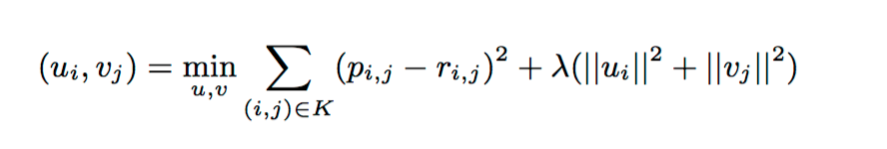
•R = {rij }nu ×nv is user-movie matrix where each item Rij represents the rating score of item
j by user i where ri,j =< ui,vj > ∀i,j.
• U represent the user feature matrix and V represent the movie feature matrix.
• Dimension of the feature space(d) is a system parameter that is determined by a hold-out dataset or cross- validation.
• The low rank approximation problem is thus formulated as follows to learn the factor vectors (ui,vj):
Where pi,j =<ui,vj > is the predicted rating ,λ is the regularization coefficient and K is the
Set of known ratings from the Sparse matrix R.

Slide 42
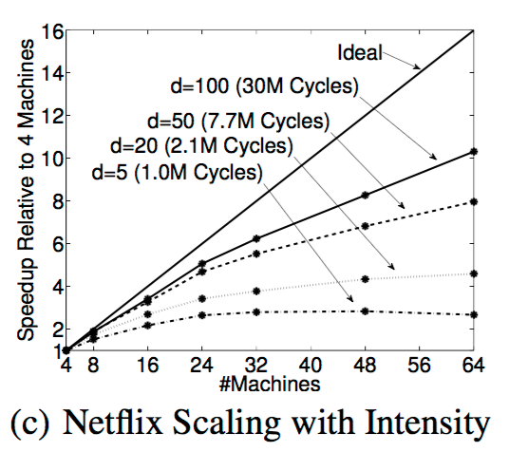
Netflix Scaling with Intensity
•Plotted is the speedup achieved for
varying values of dimensionality(d).
•Extrapolating to obtain the
theoretically optimal runtime, the
estimated overhead of Distributed
GraphLab at 64 machines is 12x for
d=5 and 4.9x for d= 100.

Slide 43
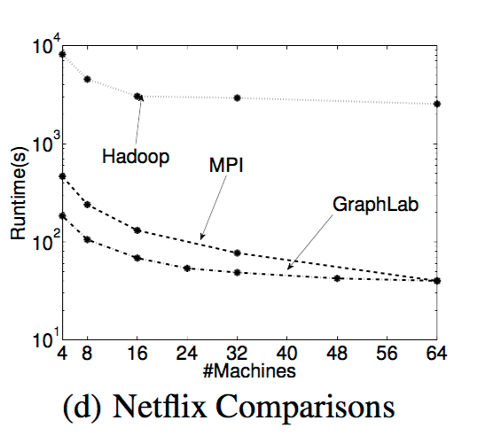
Netflix Comparisons
• GraphLab implementation was
compared against Hadoop and MPI
using between 4 to 64 machines.
•GraphLab performs between 40-60
times faster than Hadoop.
•It also slightly outperformed the
optimized MPI implementation.

Slide 44
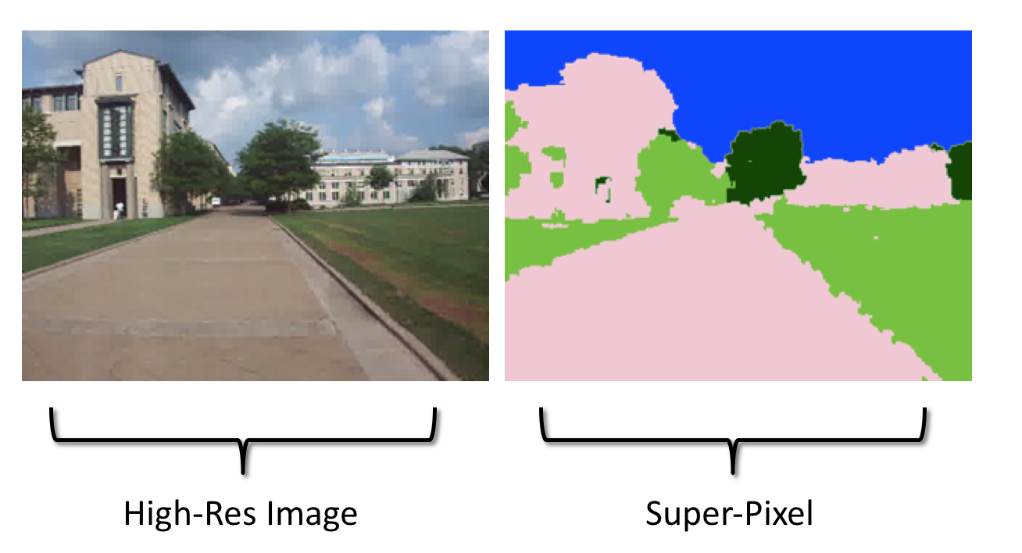
Video Co-segmentation(Coseg)
•Video co-segmentation automatically identifies and clusters spatio-temporal segments of video that share similar texture and color characteristics.
•Frames of high-resolution video are pre-processed by coarsening each frame to a regular grid of rectangular super-pixels.
•The CoSeg algorithm predicts the best label (e.g., sky, building, grass etc.) for each super pixel using Gaussian Mixture Model (GMM) in conjunction with Loopy Belief Propagation (LBP).

Slide 45
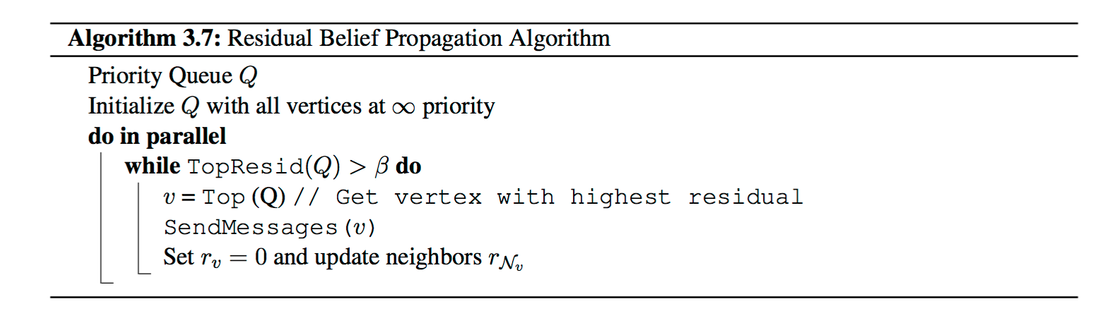
• The two algorithms are combined to form an Expectation-Maximization problem
alternating between LBP to compute the label for each super-pixel given the GMM and
then updating the GMM given the labels from LBP.
• The GraphLab update function executes the LBP local iterative update where updates
expected to change values significantly are prioritized.The BP update function is as:

Slide 46
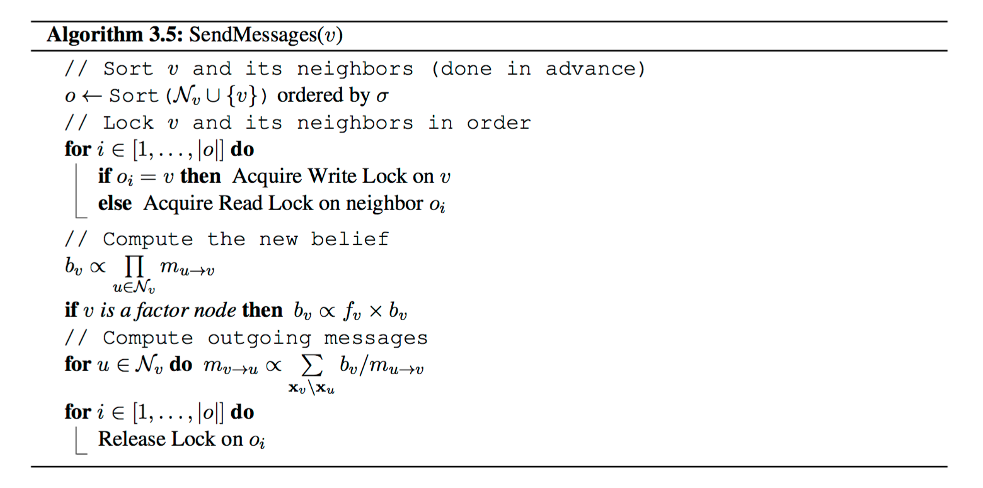

Slide 47
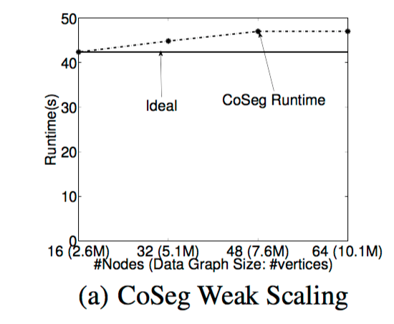
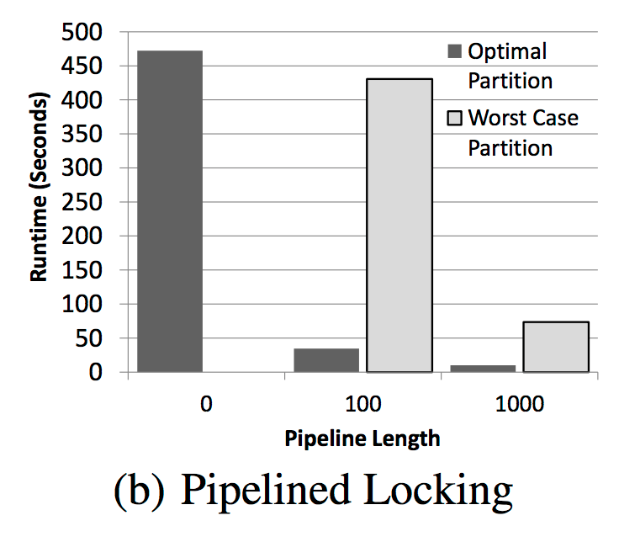
• The locking engine provides nearly optimal weak scaling: the runtime does not
increase significantly as the size of the graph increases proportionately with
the number of machines.
• It was also observed that increasing the pipeline length increased
performance significantly and compensated for poor partitioning.

Slide 48
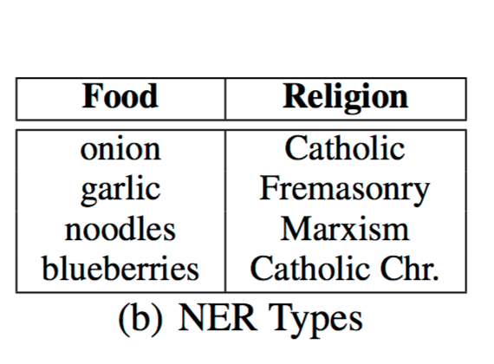
Named Entity Recognition(NER)
• Named Entity Recognition is the task of determining the type (e.g., Person, Place, or Thing) of a noun-phrase (e.g. Obama, Chicago, or Car) from its context (e.g. “President..”, “Lives near..”, or “bought a..”).
• The Data graph for NER is bipartite with one set of vertices corresponding to noun-phrases and the other to contexts.
•The CoEM vertex program updates estimated distribution for a vertex (either noun-phrase or context) based on the current distribution for neighboring vertices.

Slide 49
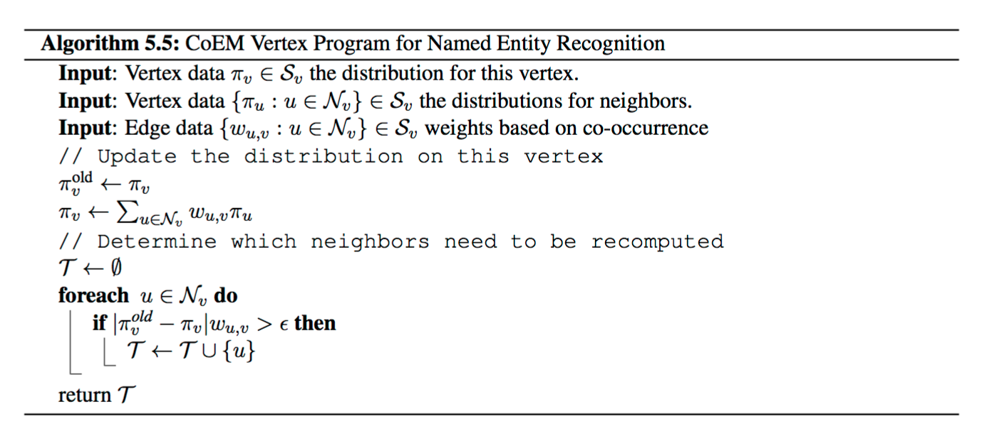
•Below is CoEM algorithm in which adjacent vertices are rescheduled ,if the type distributions at a vertex changes by more than some predefined threshold.

Slide 50
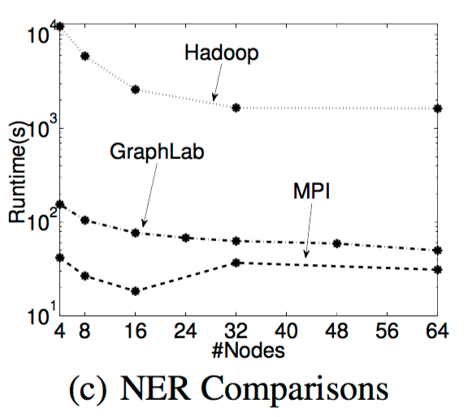
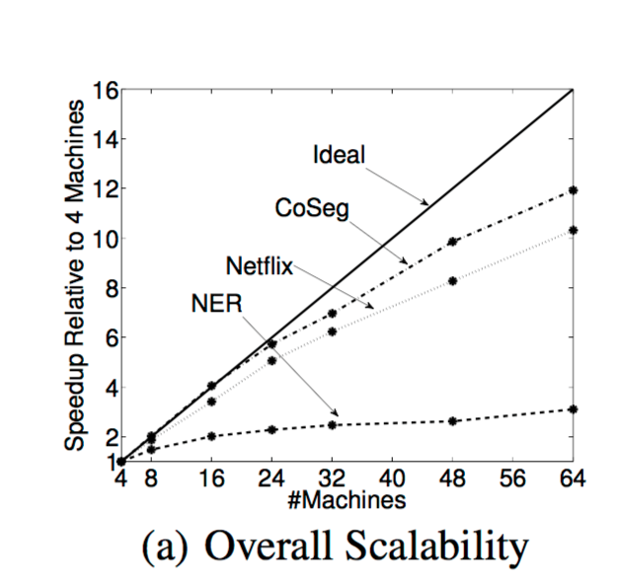
NER Comparisons
•GraphLab implementation of NER
achieved 20-30x speedup over
Hadoop and was comparable to the
optimized MPI.
•GraphLab scaled poorly achieving
only a 3x improvement using 16x
more machines, majorly due to
large vertex data size, dense
connectivity, and poor partitioning.

Slide 51
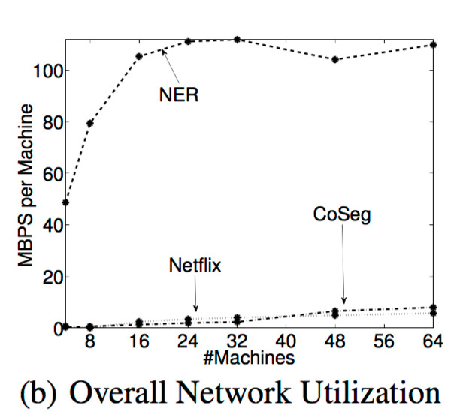
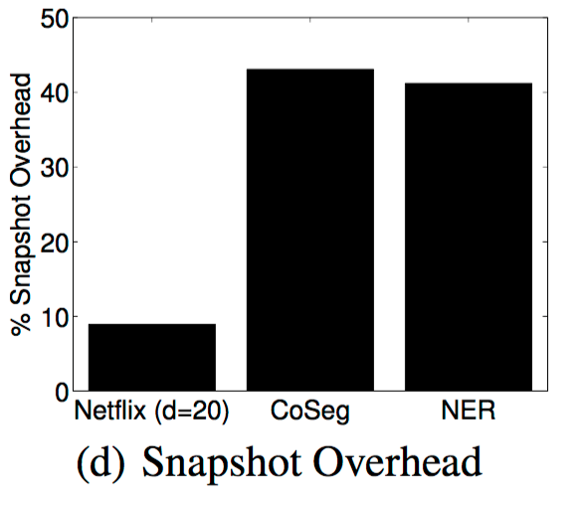
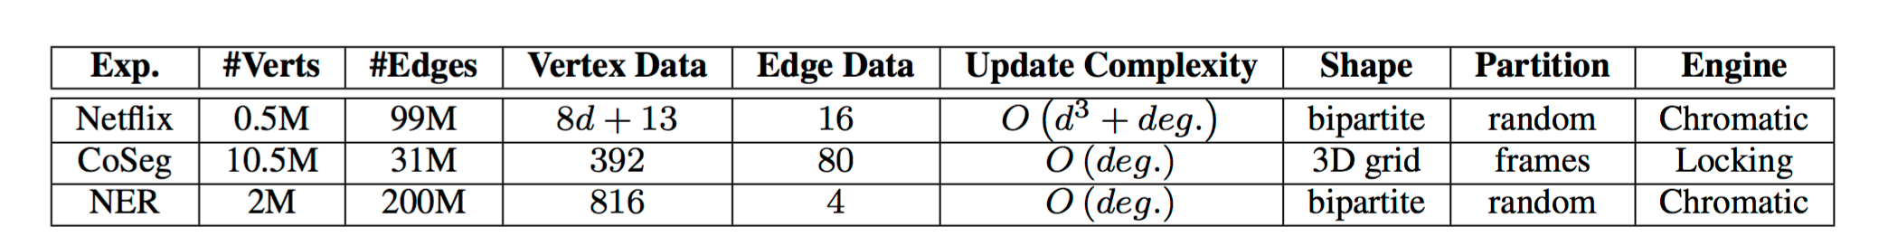
Comparison(Netflix/CoSeg/NER)

Slide 52
Comparison(Netflix/CoSeg/NER)
• Overall network utilization: Netflix and CoSeg have very low bandwidth requirements while NER appears to saturate when #machines > 24.
• Snapshot overhead: Overhead of performing a complete snapshot of the graph every|V | updates is highest for CoSeg, when running on a 64 machine cluster.

Slide 53
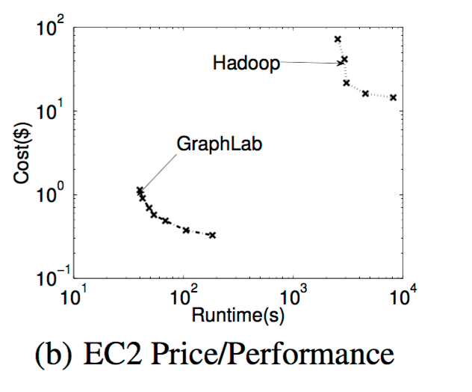
EC2 Cost Evaluation
• The price-runtime curves(log-log scale)
for GraphLab and Hadoop illustrate the
cost of deploying either system.
• For the Netflix application, GraphLab is
about two orders of magnitude more
cost-effective than Hadoop.

Slide 54
Conclusion
• In the paper we talked about:
• Requirement of MLDM algorithms.
• Graphlab extended to the distributed setting by:
•Relaxing the schedule requirements
•Introducing a new distributed data-graph
•Introducing new execution engines
•Introducing fault tolerance.
•Distributed Graphlab outperforms Hadoop by 20-60x and is competitive with tailored MPI implementations.

Slide 55
Future Work
• Extending abstraction and runtime to support dynamically evolving graphs and external storage in graph databases.
• Further research into theory and application of Dynamic asynchronous graph parallel computation thus helping in defining emerging field of big learning.

Slide 56
References
• Y. Low, J. Gonzalez, A. Kyrola,D. Bickson, C. Guestrin, and J. M. Hellerstein. Graphlab: A
new parallel framework for machine learning. In UAI, pages 340–349, 2010.
• Y. Low, J. Gonzalez, A. Kyrola,D. Bickson, C. Guestrin, and J. M. Hellerstein.Distributed
Graphlab: A Framework for Machine Learning and Data Mining in the Cloud.
• Thesis:Parallel and Distributed Systems for Probabilistic Reasoning
Joseph Gonzalez,CMU-ML-12-111 ,December 21, 2012.
• GraphLab ppt by Yucheng Low, Joseph Gonzalez, Aapo Kyrola,Danny Bickson,Carlos
Guestrin.
•Y. Zhou, D. Wilkinson, R. Schreiber, and R. Pan. Large-scale parallel collaborative filtering
for the netflix prize. In AAIM, pages 337–348, 2008.
• Christopher R. Aberger. Recommender: An Analysis of Collaborative Filtering Techniques.
• GraphLab create : http://graphlab.org.
• CS-425 Distributed Systems ppt: Chandy-Lamport Snapshot Algorithm and Multicast
Communication by Klara Nahrstedt
• CSE 547 Graph Parallel Problems Synchronous vs Asynchronous Computation pdf by Emily Fox.

Slide 57


